Slide 1
The 13th colonies in the 1700s
What were the original 13 colonies, and how were they divided regionally?
How did the natural resources and climate present in the different regions affect the development of their economies?
What were some of the reasons Europeans immigrated to the 13 colonies?

Slide 2

13th Colonies Video:
https://www.youtube.com/watch?v=Do4Ryapg3eU&list=RDDo4Ryapg3eU&start_radio=1

Slide 3
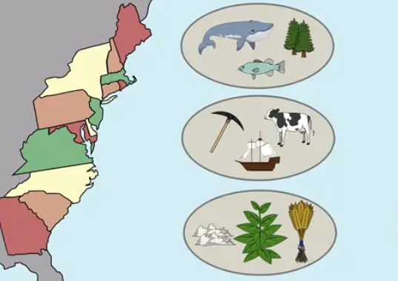
13th Colonies
Divide into three:
New England
Middle
Southern
Notes:
By the 1700s, there were 13 British colonies in North America along the Atlantic coast. Historians divide these colonies into three regions: New England, the Middle, and the Southern. The differences in their geography, climate, and natural resources allowed people to produce different products and services, which influenced the development of their industries and economy. The colonial regions also varied in their demographics and the structure of their governments. Some early local governments were more democratic than others. The different characteristics in each region influenced the colonists’ opportunities and way of life.

Slide 4
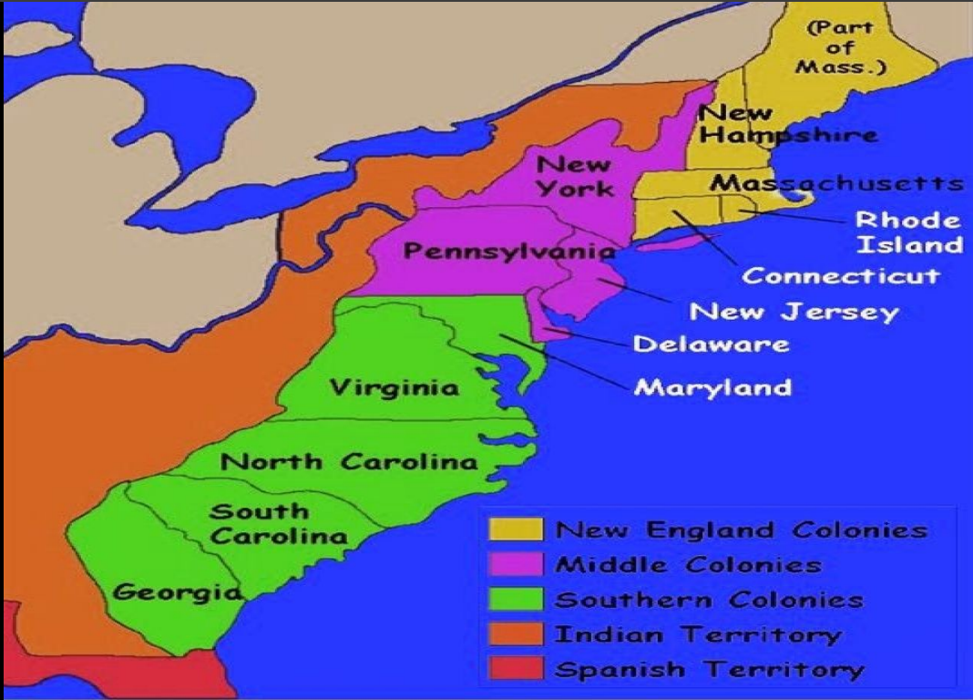
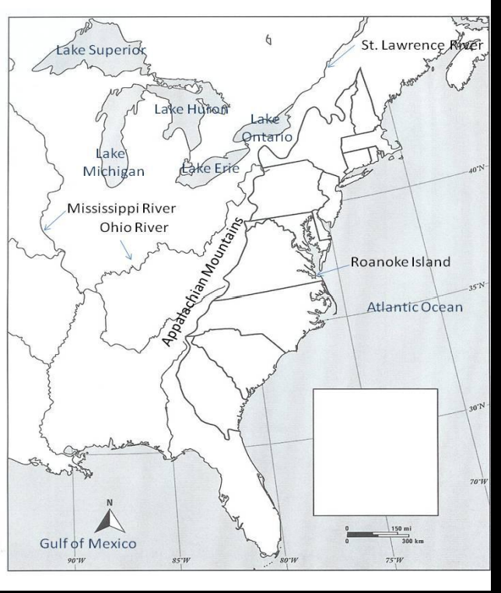
Label your map on your worksheet

Slide 5
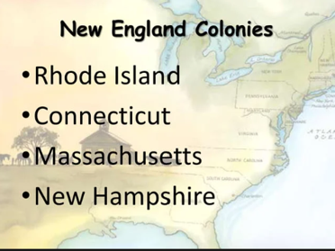

Slide 6
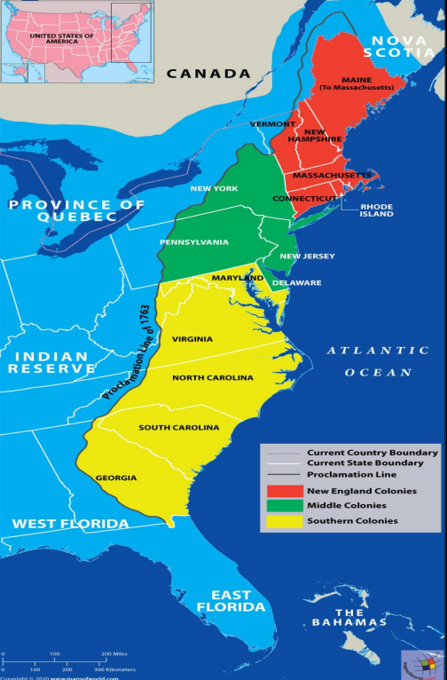
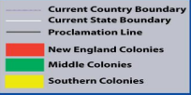
New England Colonial Life Geography
Geography:
Rocky Soil
Thick forest
Natural harbors
Climate
Cold winters
Short growing season
Cold weather kills germs & insects, so people lived longer.
Notes:
The Geography: The New England Region was the northernmost region and included Massachusetts Bay, Rhode Island, Connecticut, and New Hampshire. The climate in New England is hot in the summer and cold in the winter. While the winters were harsh, the cold weather provided a respite from insects and germs that could cause disease. New England has rocky soil, thick forests, many rivers, and easy access to the sea.
The geography influenced settlement patterns, leading to small farms and a focus on fishing, shipbuilding, and trade.

Slide 7
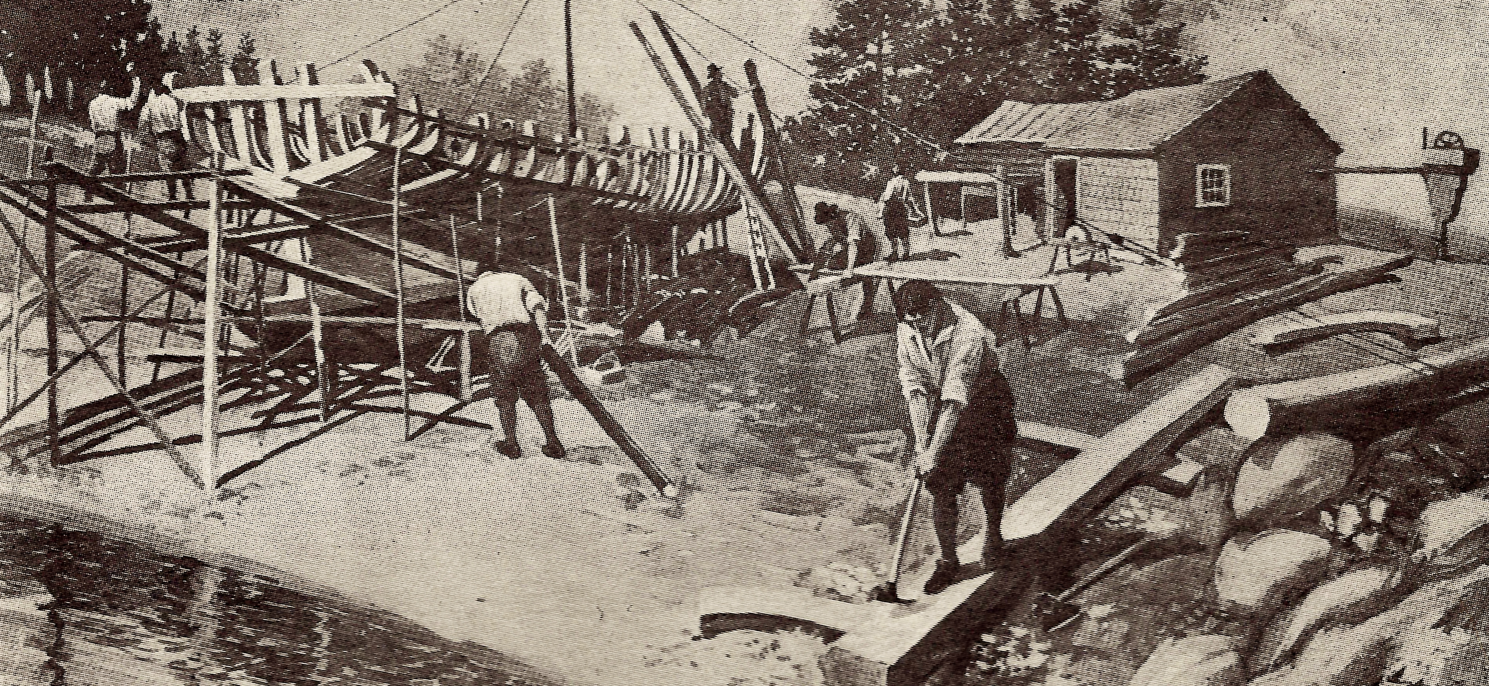
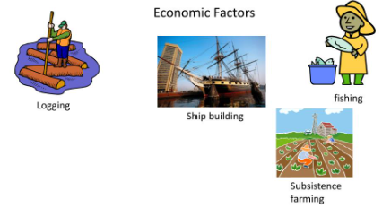
New England Colonial Life Economy
Economic activities:
shipbuilding
lumbering
fishing, whaling,
sawmills/ industry trade center.
Due to harsh climates.
This Photo by Unknown Author is licensed under CC BY-SA
Notes:
Economy: Because of these natural resources, New England’s economy includes a variety of industries. The climate and soil made it possible to cultivate the land on small farms. Crops such as corn, squash, onions, and beans could be planted in the spring and harvested in the fall. Farms could also maintain apple orchards and livestock. The many rivers and easy access to the sea enabled fishing, trapping, and trade. Cape Cod was named after the abundance of codfish. Whaling was a lucrative business as whale oil was used in every colony for soap, candles, and lamp oil. Lumber from the dense forests was used to build houses and ships.

Slide 8
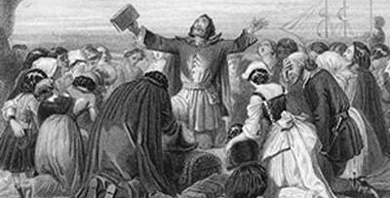
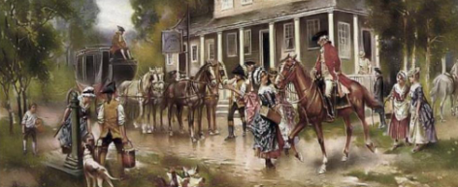
New England Colonial Life Demographic
Demographic Population primarily composed of:
English Puritans.
Society was tightly knit, reflecting strong religious and communal values.
This Photo by Unknown Author is licensed under CC BY-SA
Notes:
Demographics: The first Europeans to permanently settle in New England were the pilgrims in 1620, followed by the Puritans in 1630. They came in part to escape religious persecution by the Church of England. Religion guided every aspect of their daily lives. The Puritans were very strict in their religious beliefs and were not accepting of other religions. Because of this, an outspoken minister named Roger Williams was banished from Massachusetts and left to found a new colony in Rhode Island. He was followed by Anne Hutchinson, who also spoke out against some of the strict Puritan practices and was banished. The Rhode Island colony offered more religious freedom.

Slide 9
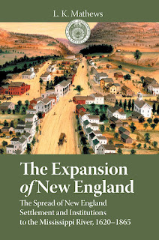
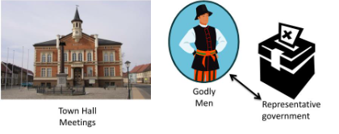
New England Colonial Life Government
Self-governed
Town meetings
Direct participation
Community decision-making
This Photo by Unknown Author is licensed under CC BY-SA-NC
Notes:
Government: The colonists in New England created a more democratic system of government than they were afforded in Europe. They held town meetings where colonists could meet and vote on local issues. Men who owned land were permitted to vote, and they elected representatives, local officials, and governors.

Slide 10
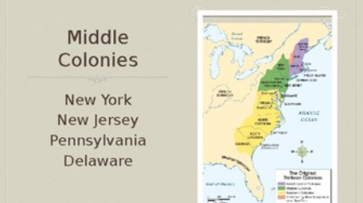

Slide 11
Middle Colonial Life Geography
Fertile Soil
Long growing season
River Transportation
Warm weather.
Notes:
Geography: The Middle Region included New York, Pennsylvania, New Jersey, and Delaware. The climate is similar to the New England region, with hot summers and cold winters. The area has large rivers and river valleys, such as the Mohawk River Valley in New York and the Susquehanna Valley in Pennsylvania. It has fertile soil and a longer growing season than New England. The region has many forests as well as abundant minerals such as iron, coal, and copper. Harbors in New York, New Jersey, and Delaware made the middle region an ideal place for shipping and trade.
Known for fertile soil and moderate climate, suitable for agriculture. Geography facilitated access to rivers, making it significant for trade and interaction.

Slide 12
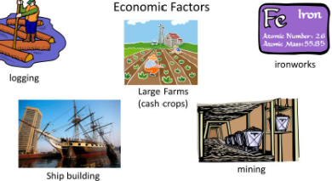
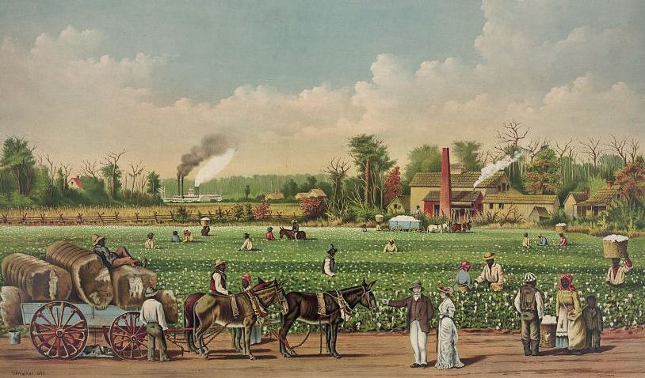
Middle Colonial Life economy
Large farming: Often termed the "breadbasket" due to its production of grains. (Wheat, oats, barley, potatoes)
Shipping Building
Logging
Ironworks
Mining
This Photo by Unknown Author is licensed under CC BY-SA
Notes:
Economy: The middle region’s resources enabled colonists to develop a strong economy. They farmed the rich soil, cultivating wheat, corn, vegetables, and tobacco, and raised livestock such as dairy cattle. The rivers provided a means of transportation for trade and trapping. Many other colonists were merchants, miners, sailors, or lumbermen.

Slide 13
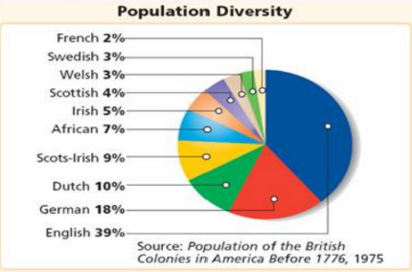
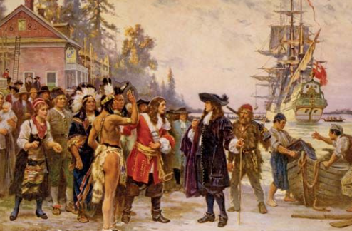
Middle Colonial Life Demographic
English
Germans
Dutch
Italian
Irish
And others
Notes:
Demographics: The Middle Colonies attracted diverse groups of Europeans. New York was first settled by the Dutch before it became a British colony. Immigrants from Germany and Ireland also flocked to the middle colonies for the opportunities they offered. Similar to the Puritans, Quakers faced persecution in England for their religious beliefs. William Penn was granted permission by King Charles II in 1681 to found a colony in Pennsylvania where the Quakers could live peaceably.

Slide 14
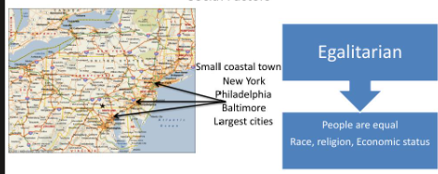
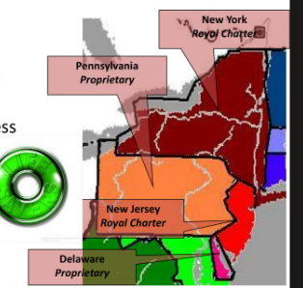
Middle Colonial Life Government
Proprietary Charters
Ruly by:
Equality
Religious Tolerance
Freedom of the Press
Strong court systems
Notes:
Government: In New York, colonists had less power in their government. As a royal colony, its governor was appointed by the king. The governor, in turn, appointed other officials. Pennsylvania was a bit more democratic. Men with property were allowed to vote for members of an assembly who would write their laws.

Slide 15
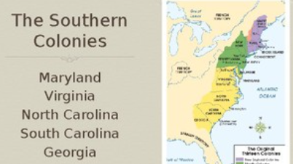

Slide 16
Southern Colonial Life Geography
Geography
Broad coastal plain
Swamps
Forest covers hills
Mountains
Climate
Mild Winters
Long, hot, humid summers
Thriving insect and disease.
Notes:
Geography: The Southern Region is the southernmost region and includes Maryland, Virginia, North Carolina, South Carolina, and Georgia. The climate is very hot and humid in the summer and mild in the winter. There are forests, accessible harbors along the coast, rivers, and swamps.

Slide 17
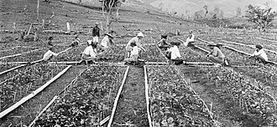
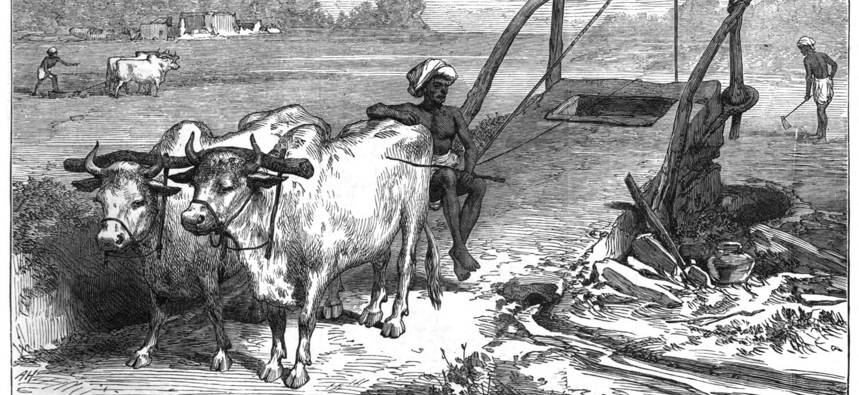
Southern Colonial Life Economy
Commercial agriculture:
tobacco
rice
indigo
The plantation system
slave labor played a crucial role in the economy.
This Photo by Unknown Author is licensed under CC BY-SA
This Photo by Unknown Author is licensed under CC BY-SA-NC
Notes:
Economy: Because of the long growing season, the southern colonies were able to produce an abundance of cash crops such as tobacco, rice, indigo, and cotton. These were farmed on large plantations that required extensive manual labor. To increase their profits, southern plantation owners used the labor of Africans who were stolen from Africa and forced into slavery. While slavery existed in every colony in the 1700s, it was particularly entrenched in the South. Lumbering and trading were other industries in the southern colonies

Slide 18
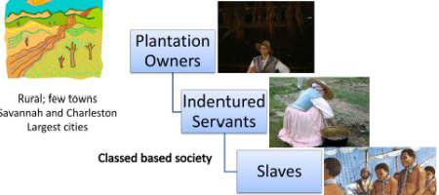
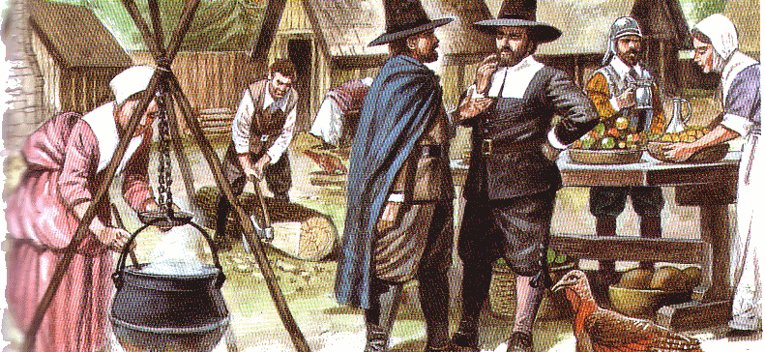
Southern Colonial Life Demographic
Wealthy plantation owners (Puritans & Quakers)
enslaved Africans
Service indenture (small farmers).
Social structure was hierarchical.
This Photo by Unknown Author is licensed under CC BY-NC-ND
Notes:
Demographics: Similarly to the Puritans and the Quakers, Catholics faced religious persecution in England. Cecilius Calvert (also known as Lord Baltimore) founded the colony of Maryland in 1634. He sought to make money from the regions’ rich resources and also provide a safe haven for Catholics who were denied rights not only in England but in other colonies. Georgia, on the other hand, became a British colony in 1732 for the purpose of keeping the Spanish in Florida from trying to advance northward. To begin the colony, British debtors were offered the chance to avoid jail time by agreeing to help settle the land. They were given the opportunity to cultivate 50 acres of land to pay off their debts.

Slide 19
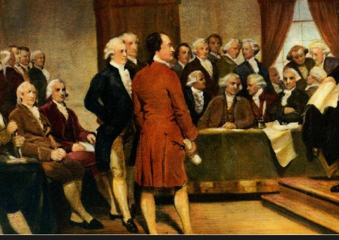
Southern Colonial Life Government
Plantation owners often held power.
The House of Burgesses
Colonies run for the profit of the Joint-Stock Company or the Proprietors.
Notes:
Government: At first, slavery was illegal in Georgia. However, in 1752, all white men were given the right to vote for members of an assembly, after which new laws were passed that made slavery legal. In Maryland, white men with property were allowed to vote for members of the assembly, the lawmaking body.

Slide 20

Storyboard Conflict of the Colonies, text page 98
Assignment

Slide 21
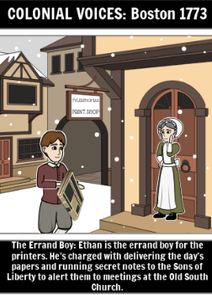
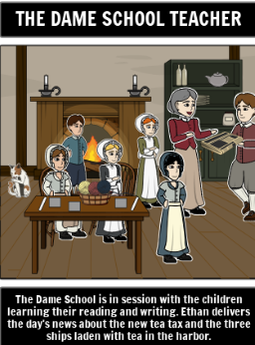
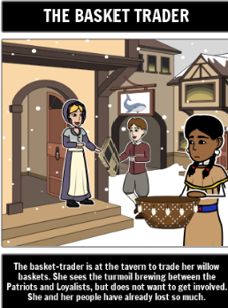
Figure 1
Figure 2
Figure 3

Slide 22
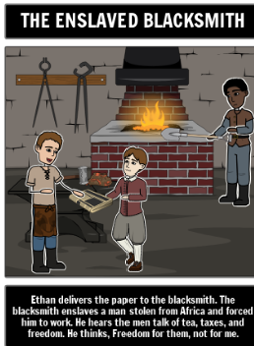
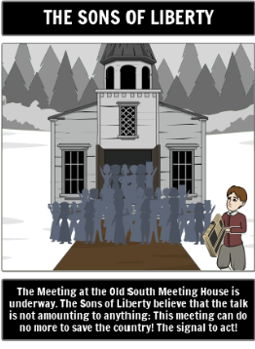

Figure 4
Figure 5
Figure 6

Slide 23
STOP NEXT Lesson

Slide 24
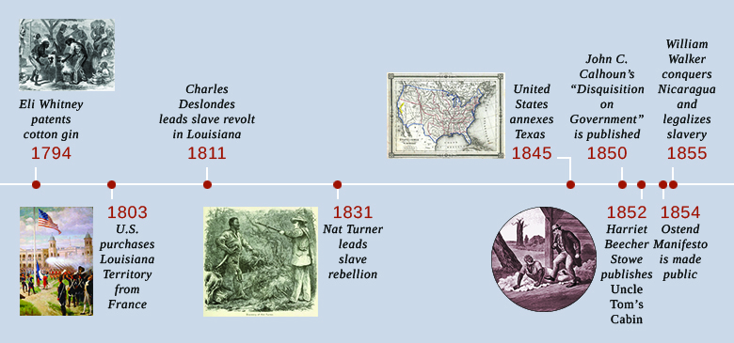
This Photo by Unknown Author is licensed under CC BY

